Slide 1
Enabling Continuous Delivery

Slide 2

Meet Henry
(Our Business Owner)

Slide 3
Meet Henry
(Our Business Owner)
He needs an app built in the next 8 weeks
He knows what the app should do
He expects competitors to try to beat us to market
Notes:
doesn’t really know anything about software development
if he doesn’t get something out the door, almost no worth even trying, they will have ceded market advanatage

Slide 4
Meet Jane
(Our App Architect)

Notes:
she’s worried

Slide 5
Meet Jane
(Our App Architect)

Jane is a little worried:
Not everyone understands agile here
Environment setup takes a long time
8 Weeks isn’t much time to get a release to production (!)
Notes:
environment setup often takes longer than 8 weeks, putting aside how long it takes to develop
not long enough to traverse traditional release mgmt

Slide 6
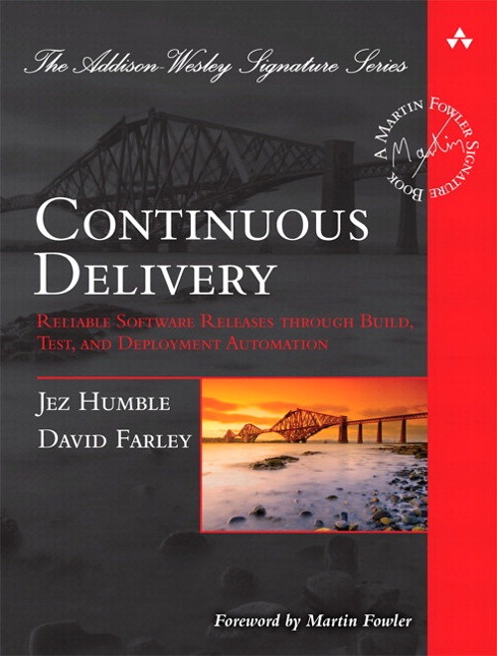
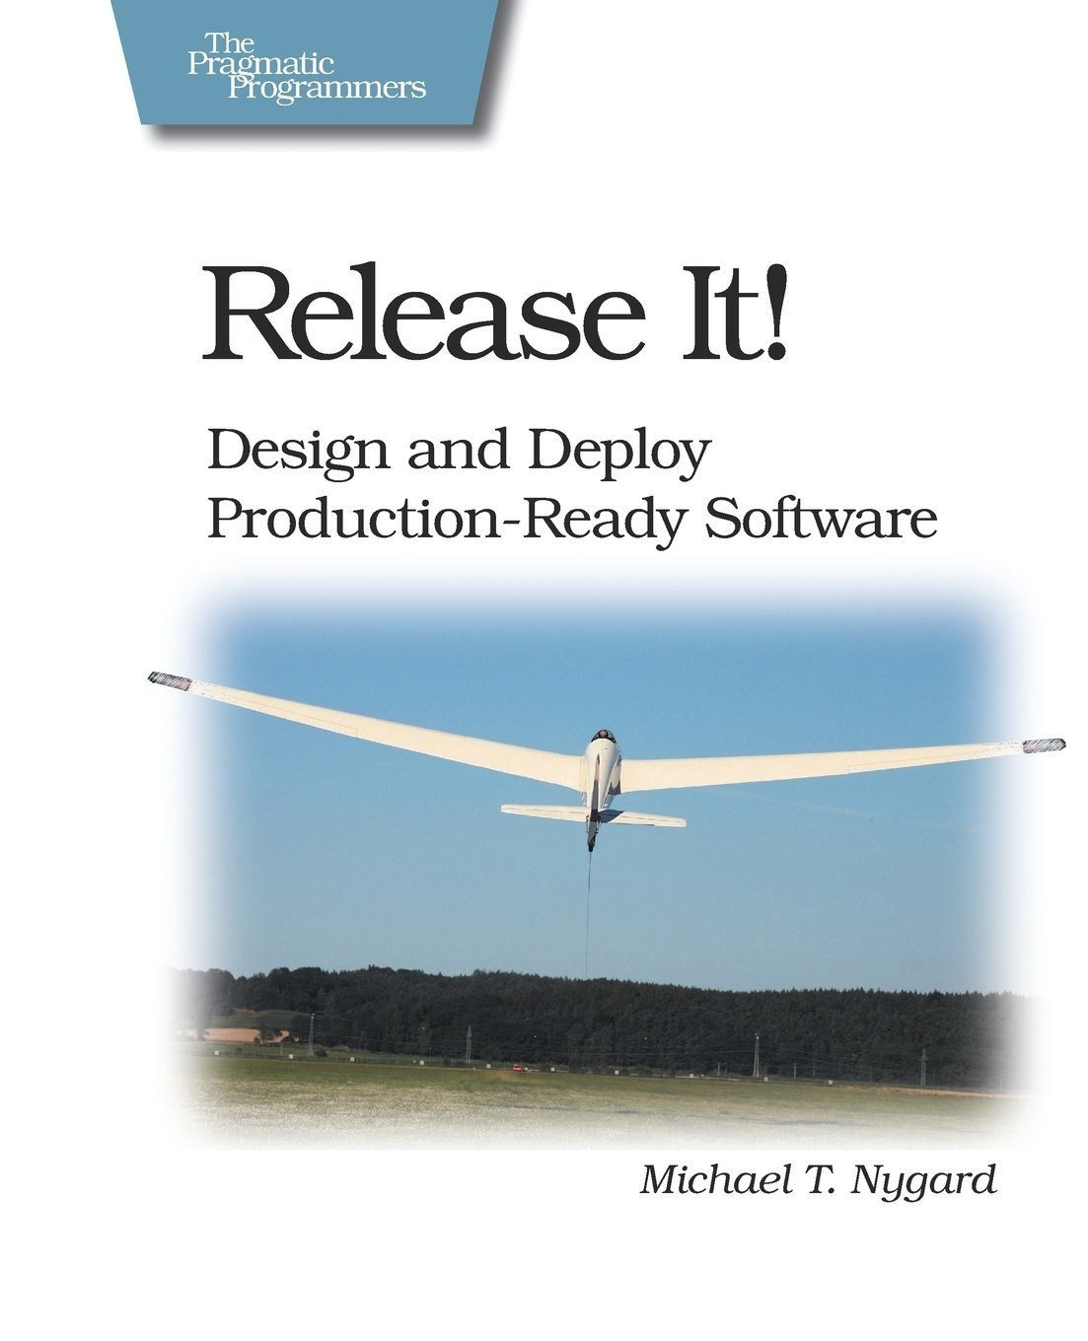
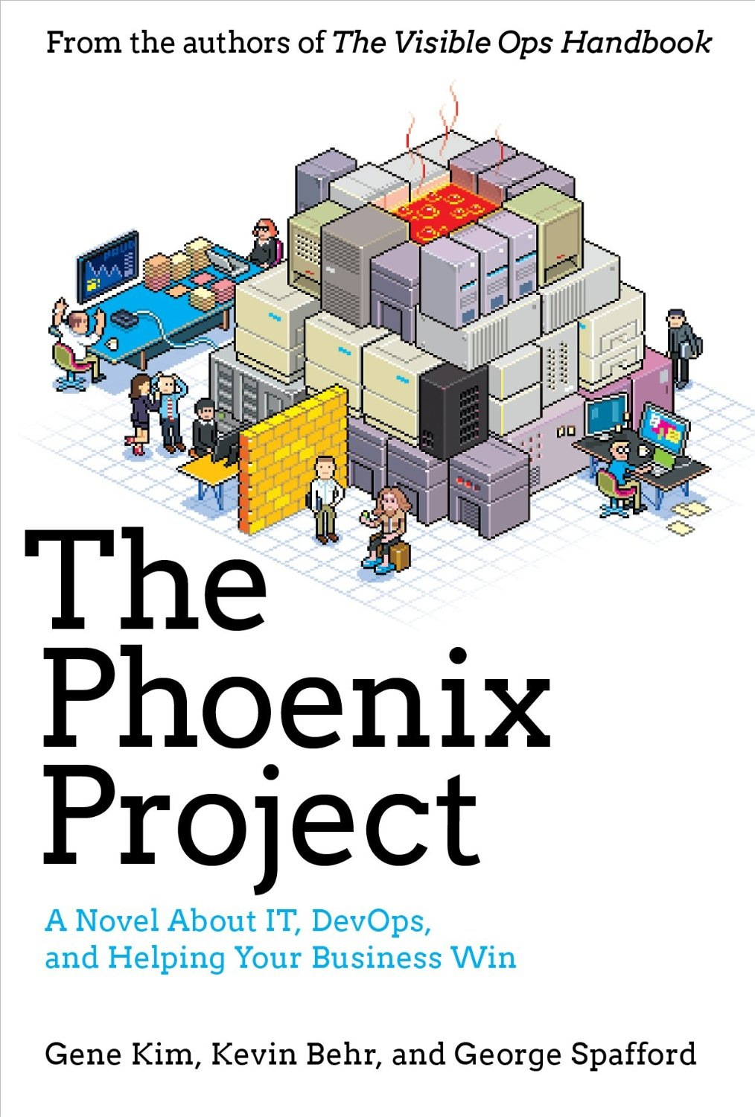
Continuous Delivery To The Rescue!
Notes:
Jane did research on continuous delivery
she read these books
maybe you’ve read one or all of these…you probably have varying opinions
all well intentioned, help understand how to engage in continuous process redesign, shortening time it take to get htings done

Slide 7
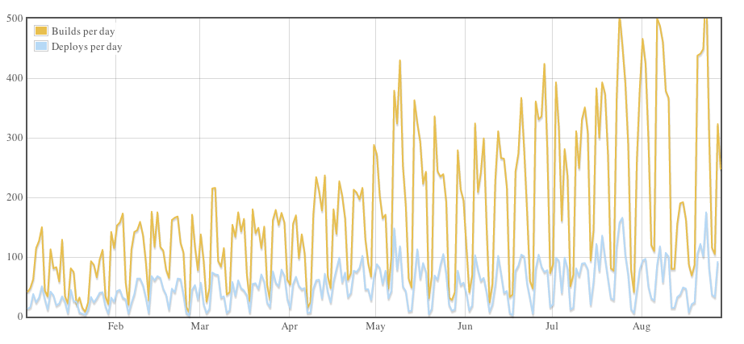
Continuous Deployment
Github: On August 23, 2012 – 563 builds and 175 deploys
github.com/blog/1241-deploying-at-github
Notes:
walked away with misunderstanding
continuous deployment different to continuous delivery
github - probably makes release management people very nervous - THIS IS EXTREME

Slide 8

Continuous Delivery != Continuous Deployment

Slide 9
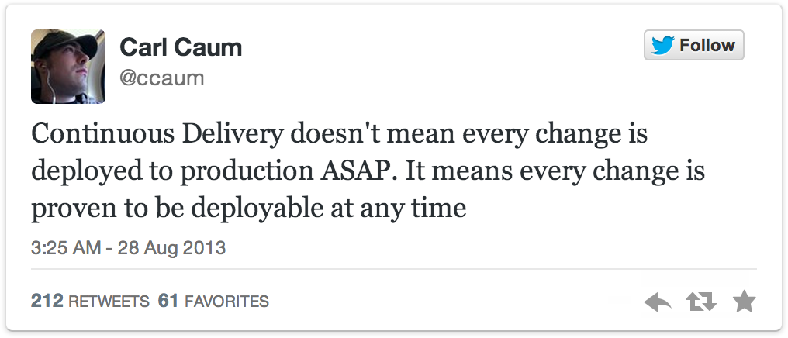
Continuous Delivery != Continuous Deployment
twitter.com/ccaum/statuses/372620989257232384
Notes:
Carl is Product Owner @ Puppet Labs
main difference - verifying if each change is a release candidate and potentially deployable, or not a release candidate and development/testing activity required to remedy that

Slide 10
The Difference:
Who Presses The Button
For A Production Deployment?
Notes:
ultimately what we’re trying to get to
only difference is that we have such a high rate of automation and efficeint process, we have traditional manual approval processes around WHEN we push the button to prod with specific feature and we usually have a WHO that pushes it
most orgs want some separation of responsibilities b/w preprod and prod envs

Slide 11
What Could Get In Jane’s Way?
Notes:
many things you might recognize in your organization today

Slide 12
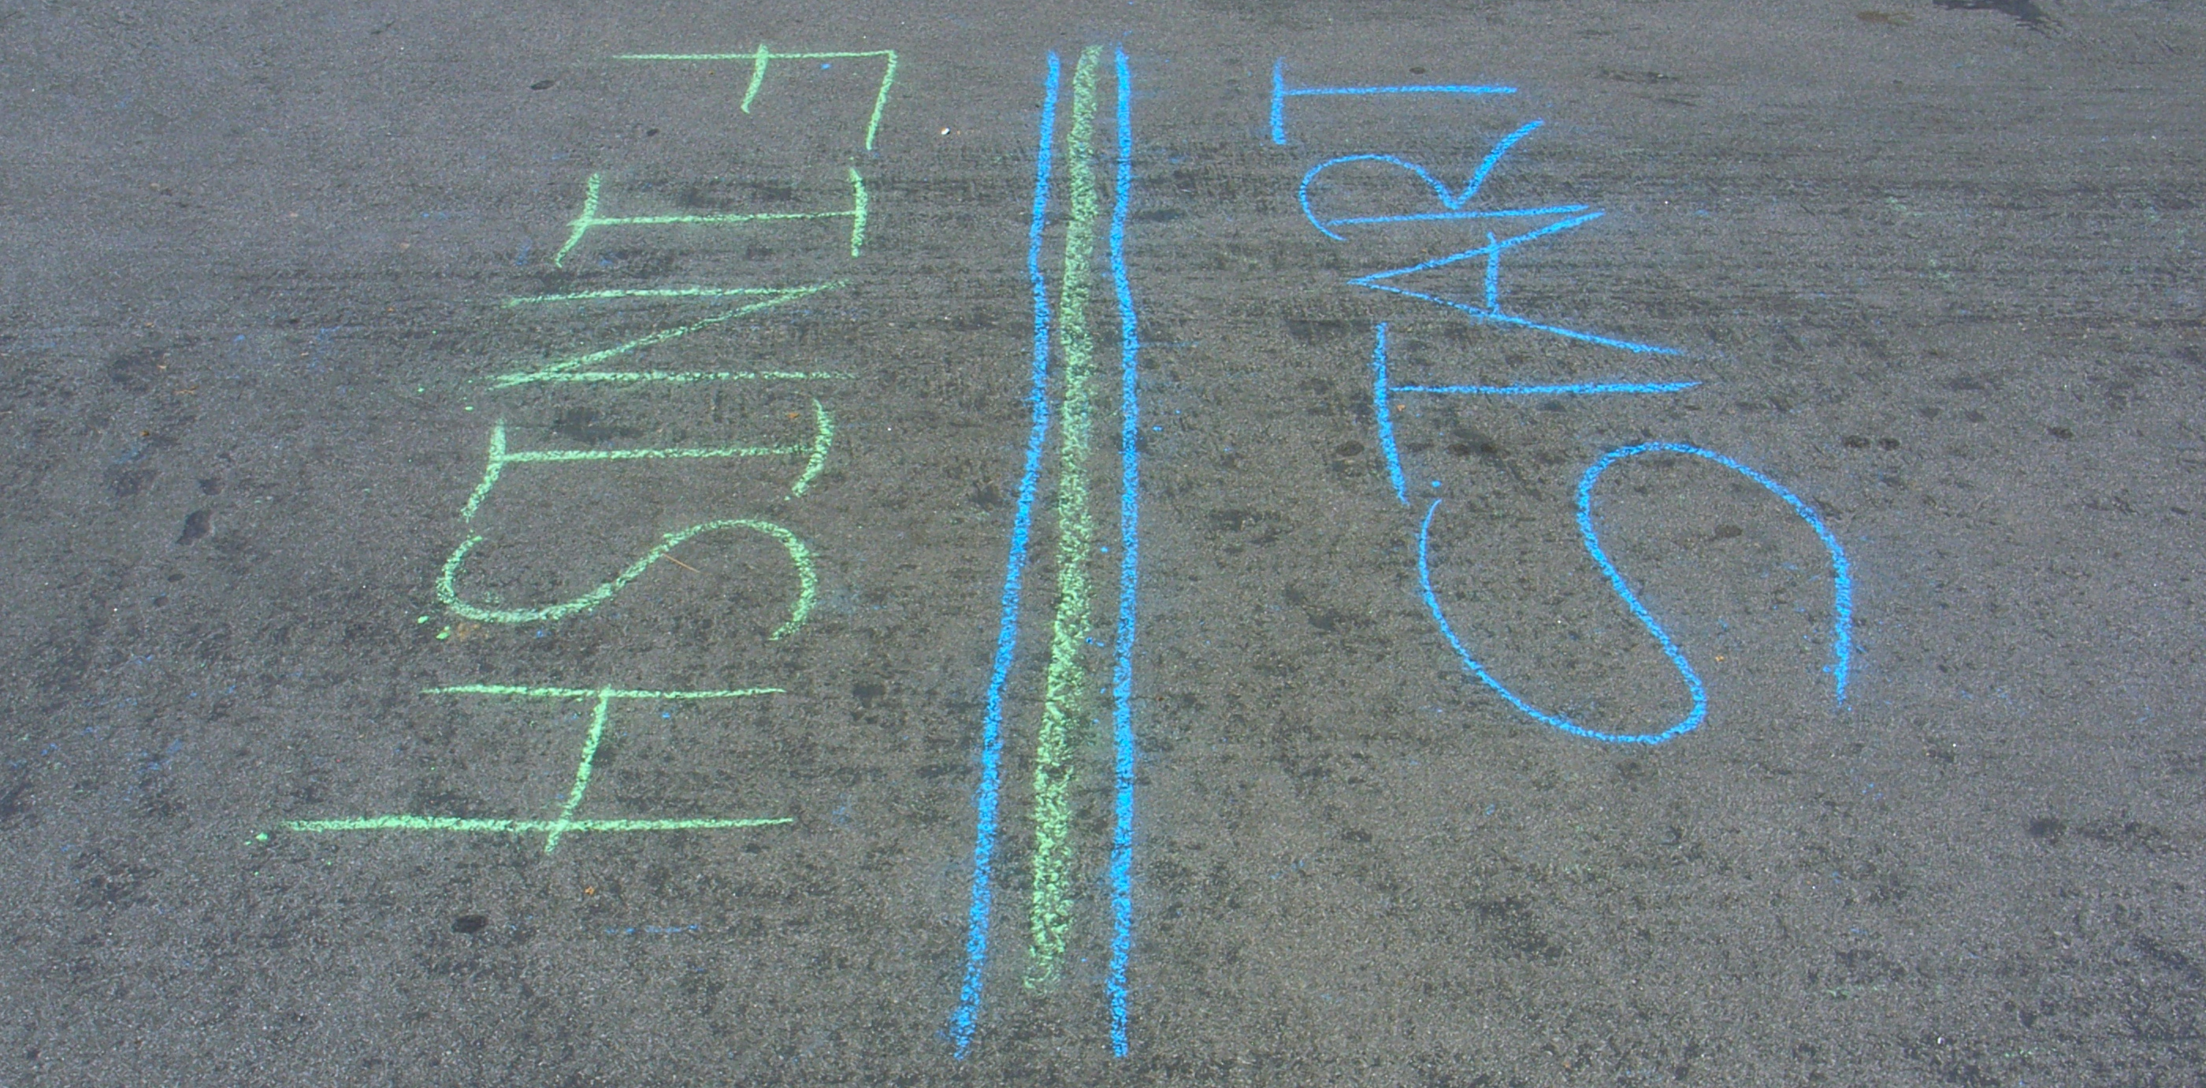
Cycle Time
How Long Does It Take To Deploy
One Line Of Code To Production?
www.flickr.com/photos/nnova/3399904953
Notes:
cycle time is critical
how long to deploy/release one line of code into production
all surroundint prorcess….testing, RM, change control
most orgs = months, maybe one release per year
ultimately we want to get to short cycle time
low overhead to doing releases
just choose what features you want in prod and when

Slide 13
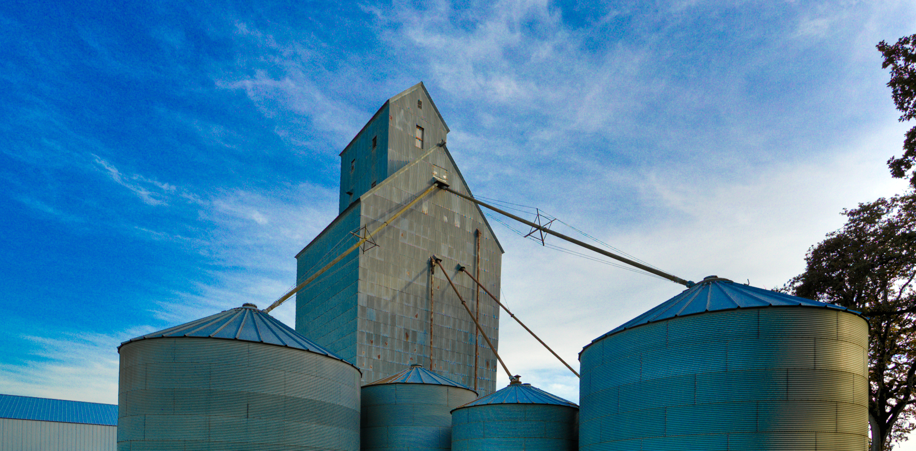
Silos
… But We Have A DevOps Team!
www.flickr.com/photos/denimdave/6334224428
Notes:
siloing
banner reason for devops
unifying across org boundaries
sometimes fall into trap of creating devops team….new silo (not ncessairly bad, as long as we’re still orging across silos, not throwing over the wall)
change mentalithy as develoeprs
understanding infrastructure,m testing, what is like to be in prod ops
operations - how app is built, how we get there (process), what impact is there in slowing rate of change to prod by implementing heavyweight process, reason we might want ot change those
ultimately is a function of communication, and we really need to be ery viliglant about breaking down walls between parts of org, engaging in a shared understanding across those silos

Slide 14
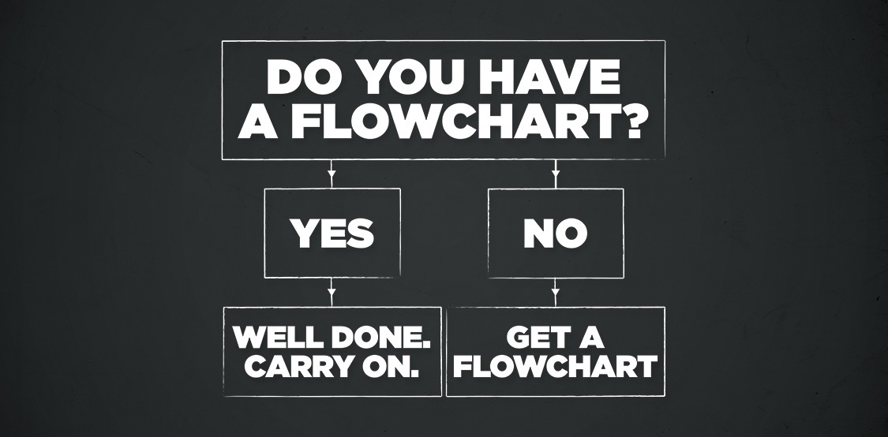
Process
You Need To Open A Ticket For That!
www.flickr.com/photos/kevgilmour/4843051331
Notes:
hand-in-hand with that
process in Jan’es org is not geared toward helping getting features into prod
for good reason - many processes are designe dto limite chang toe production to ensure uptime, availability, reliability, other metrics all very valuable
key is when we get stuck in the old way of doing things and don’t reasses continually, we might be giving up lots of advatangate s for doing things differenlty and better
a big part of this is constantly reasssessing,..is this the right way to do things?
even if you imeplement new processes based on this talk, we still want to revisit periodically and make sure we’re still where wa tot be

Slide 15

Feedback Loop
Are We Building The Right Thing?
www.flickr.com/photos/tenspeedphotography/5450456783
Notes:
very important in agile softwre development
many epople are embarking down the path of adopitng agile and having varying rates of sucess
invariably see many people creating lots of great features, perhaps with scrum, churning them out every 2-3 weeks
then hit wall of release management process
feedback loop of agile really isn’t realized
features sitting there with real value that could be delivered to customers that end up sitting there
problems due to release scheduling, deps b/w applications, change control windows, variety of other factors
so part of what we need to do to enable CD in org is enable an agile infrastructure where we can pluck 1 feature out of 20 and move to prod on its own in isoliation, while leaving more dependant changes to wait for their deps to be complete so they can be deployd as discreet unit to prod

Slide 16
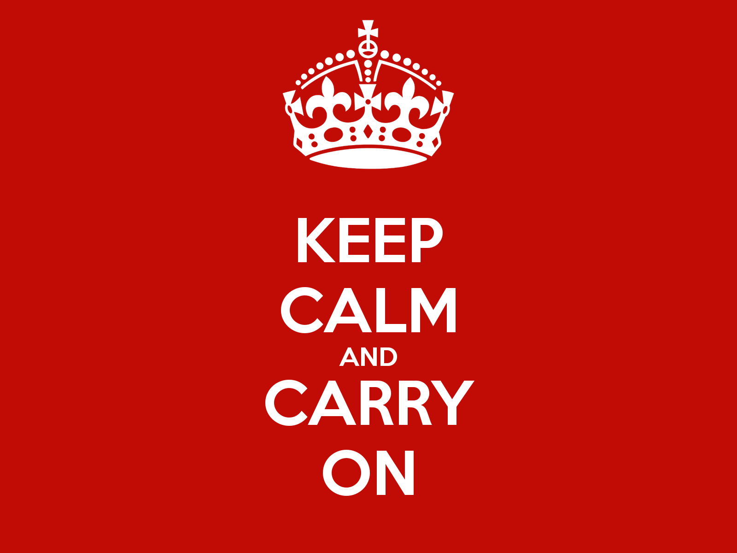
Change
Production Breaks When Changes Are Made (!)
… Right?
Notes:
change is a really difficult thing even when its good
even when great things happen to people, still difficult to adopt that change
IT orgs really resistent to change to software — prception, rightly or wrongly, that change leads to production outages
it is in our berst interest to embrace process redesign and automation to ensure that change doesn’t break production
and in fact, when using a process that implements CD, that we have LESS prod outages as a result of that

Slide 17
Jane Needs Some Help
(This Seems Insurmountable)
Notes:
all hypothetical and conceptual
patterns in release mgmt
specifically how you might implement CI/CD process to avoid traps that often get people bogged down in variety of issues

Slide 18
Strategies For Success

Slide 19

Strategies For Success
Do Implement Continuous Integration
Notes:
do not do any manual building and deploying
assume you’re already doing this
see value in product like Jenkins
won’t brelabor….suffice to say, should be first thing set up for new project
get single line of code…MVP…going through piipeline before starting devleopment

Slide 20

Strategies For Success
Do Not Create Environment Specific Packages
Notes:
multiple environment specific artifacts being produced
dev/test/stage/prod builds
why?
they are embedding env specific config into artifact (props files transformed, connection strings, credentials in package)
move twoard a single deployable artifact that can be promoted thru pipeline
verifyiable, auditable, promotable thing
higihyl repeaetble process

Slide 21


Strategies For Success
Do Externalize Environment Specific Configuration
Notes:
externalize all of that environemnt sepcific config
CF really provides great ways to do this

Slide 22

Strategies For Success
Do Automate Everything
Notes:
really isn’t a reason to have a CI pipeline that isnt’ fully automated
will be manual process surroinding things like “are we ready to promote a specific release to a new env?”
good - ensure communicating acorws silos
high rate of autmation prevents mistakes, potentaially not following process

Slide 23
Strategies For Success
Do Not Assume Existing Processes Are Right
(Engage In Continuous Improvement)

Notes:
This Is True Even When You’ve Implemented New Processes & Automation
can’t rest on laurels
do retrospectives when notice thigns go wrong badly
take opps to continually enhance these things
potentially realize new processess as a result of the fact that your’e able to focus on continually making things better rather than continuing to execute the same old process

Slide 24
Strategies For Success
Do Not Use A Different Process For Different Environments
Notes:
BIG TRAP
one way for building/deploying in preprod
certaqin point (maybe UAT/stage), a different team takes over w/ slightly different processes
maybe new builds
DANGEROUS
converge these activites onr epeatedly executing same thing targeting different envs
increase likelihood we spot an issue early and able to fix it once for all envs
Production Deployments Should Use A Process That Has Already Been Tested In Previous Environments

Slide 25

Strategies For Success
Do Recreate App Environments Frequently
(Also Known As: Servers Are Not Children)
Notes:
wage a bet…most workloads running in your org today are running on infrastructure created six months to a year ago at least (maybe 2-3 years)
burning down app environments is very positive thing
sounds scary
but introduces variety of important positive things: behavior, process, technology itself
if able to recreate over and over, they can become discardable very easily
obviously your data is not…you need appropriate data mangagement/governance strategies
but much of infrastructure is disposable…app servers, middleware - with right process, right API’s to automate, right automation on to pof those API’s
persued to logical conclusion…do not have things like state stored on servers that’s not on other servers that need that state
might have someone log into a server, update a config file, but then forget to do it on other servers…then “well this works in env X but not env Y”….then you get to track that down….very time consuming thing, shows potentially significant differences are there that you don’t even know are causing/might cause issues?
freq not done b/c provisioning time for new servers, config firewalls, load balancers, etc. is meaured in months….just too hard
but there are tools available now that help you do this (CF)

Slide 26

Strategies For Success
Do Ensure Database Changes Are Automated
Notes:
long pole in the tent is often the DB
variety of techniques you can use to ensure CD of your app w/o invoking traditional processes for DB change mgmt
not to say you have to….can potentially decouple and engage in trad. DB change mgmt
using migrations, fwd/bwd compatibility of app w/ DB might allow enabling features once DB changes are made
have app query that while running to determine which features to enable/disable
variety of techinques here…laregely arch discussion
more you can enable automation in DB changes, feature toggles based on DB changes, more successful you will be

Slide 27
Strategies For Success
Do Deploy Less More Frequently
     
     
     
   
v2.1
v2.1
v2.2
      
v2.3
  
Notes:
people w/ long cycle time often do MEGA releases of functionality
maybe 1-3 months worth of change pusehd in one big releas to prod
where possible, we want more release, more frequently, less change in each
couple of great benefits:
exerrcise our proces more often, increasing confidence it is good, implemented well, does not break. If it does break, we can catch it and fix it early such that it does not effect future chagne.
each set of changes is smaller, this means that the chagne is fresher in the midns of devleoeprs, so if something goes wrong, reediation is easier, rolling back change is easier b/c less has occurred, takes less effor
lower risk profile of deployments, saving time, delivery more fn to prod sooner, more value closer to when created by devs

Slide 28




Strategies For Success
Do Automate All Testing Where Test Failures Would Prevent A Production Release From Occurring
Notes:
testing really really important when increasing rate of change to prod
if we implement automation w/ no tests
prod ops team will be upset, RM team will be upset….who knows if app works? could increase churn of how we do releases, more rollbacks if we deploy critical issues to prod
“but I don’t have time to go back and write tests for everything”
ok…write one. one automated functional test that goes to home page of app and logs in…at least then you have something. each incremental test after that is easier to add, b/c you’ve done the hard overhead work
be pragmatic…if you have large testing teams, doesn’t mean they go away. help them go to higher valued testing. rather than repeatedly executing regression, move to exploratory, discovery-based testing - humans good at this! machines not as much
increase level of confidence is processes ability to verify application is good….reach point where build is green, happy to go to prod. yellow/red - why failed? open defect for dev organization

Slide 29


Strategies For Success
Do Try To Use Tools That Support The Process
(But Don’t Get Stuck In Tool Selection Hell!)
g
Notes:
spreadsheet analysis of everything under the sun, decision by committee as to what should be used
strategy - pick an example, real project and put thru process using candidate tools
make decision “in crucible of reality” rather than in abstract of ppt presentation or excel spreadsheet

Slide 30
Cloud Foundry Helps Jane…
Notes:
haven’t talked about CF much….deliberate
this is as much a process and people challenge as it is a tools and tech challenge
CF provides great ways to support the process change, automation, other initiatives you would pursue in trying to achieve good CD process

Slide 31

Cloud Foundry Helps Jane…
Get A New App Environment In Seconds
_{in a}

Slide 32
Cloud Foundry Helps Jane…
Have Complete Consistency Between Environments
Notes:
because Linux containers
able to isolate runtime env for each app, guarantees consistency across envs
gets us out of legacy env config drift

Slide 33
Cloud Foundry Helps Jane…
Have A Consistent API To Automate Deployments
Notes:
will exercise this in the lab in a few moments
chef/puppet/shell scripts/powershell on windows….take a VM, get it configured to spec
orchestration needed to make VM’s
that is maybe a “lower level” automation/orchestration
CF provides layer of abstraction on top of that….CF creates VM’s on our behalf, provides consistent runtime container, BP process makes laying down of JRE, Tomcat, app consistent
new constructs in API for things like apps and services (external deps or app needs—>db, messaging, blobstore, fileshare), env specific config like ENV variables
b/c higher level constructs, decreases amount of automation you need to do
makes automating full lifecylce much easier to approach and maintain…GOOD!

Slide 34
Cloud Foundry Helps Jane…
Inject Environment Specific Configuration

Slide 35
Cloud Foundry Helps Jane…
Inject External Dependencies
Notes:
not sure of your current approach:
property file hell…one huge file for all environments
external DB’s
webservices
CF allows VC of manifests, or can embed into Jenkins deployment proc, Gradle/Maven plugin

Slide 36
Cloud Foundry Helps Jane…
Promote Apps Through Environments With The Same Process







Notes:
not necessarily a trivial thing
need automated functional/acceptance tests to gate promotion thru environments
track back to root reason your current processes exist…
why do we have risk reviews?
super super important to use same process across env….ensure manual processes are overlays, not blockers that introduce days/weeks/months into process

Slide 37
Cloud Foundry Helps Jane…
By Providing New Options:
+ Canary Deployment
+ Zero Downtime Deployment
+ A/B Testing
+ Scale Apps On-Demand
+ Autoscaling Apps
Notes:
canary - validation..smoke test

Slide 38

App Developers Can Be More
Successful When They Are Supported
By Agile Infrastructure
Notes:
adopting agile for software development is great until you hit the wall of release management and operations

